Slide 1
Biblical
Conflict Resolution
What must we know and practice – 50 Years into the Journey?

Slide 2
Your Presenters Today
Marvin Schick MA, LMFT, EMDR Specialist
Marion Kush LSW
Christ Follower, Servant of Kairos Culture
Husband, Father, Grandfather, Great-Grandfather
Spiritual Director – Kairos of Texas
Kairos Volunteer – Recruiting Coordinator for Torch Gainesville, TX
Licensed Marriage and Family Therapist in private practice in McKinney, TX – 13 years
Former Senior Business Analyst for PepsiCo/Frito-Lay for 31 years
Christ Follower, Servant of Kairos Culture
Mother, Grandmother
Ordained Anglican Minister
Spiritual Director – Kairos of Pennsylvania
Kairos Volunteer- Kairos Inside SCI Muncy/ PA past Kairos Outside
Licensed Social Worker, Clinical Care Manager

Slide 3
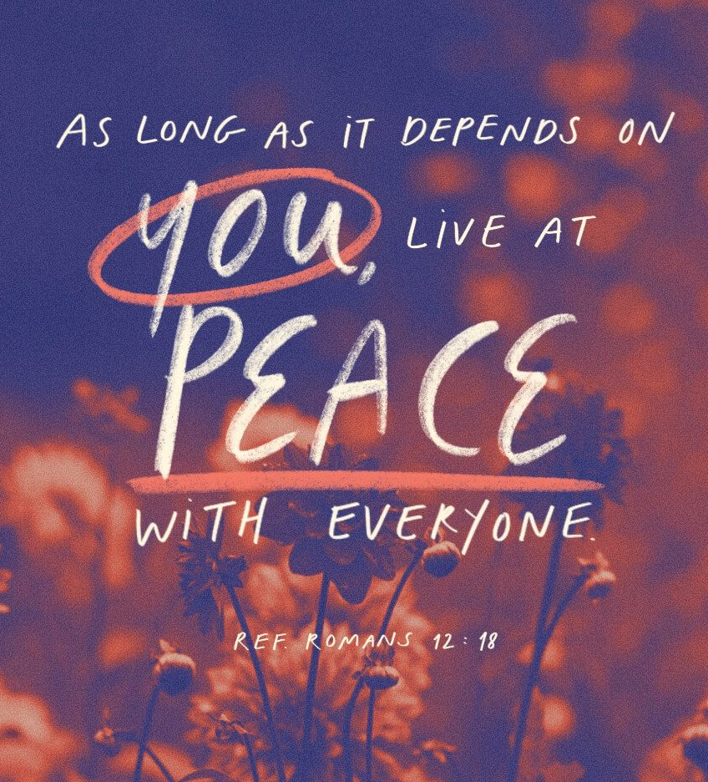
Opening Devotion
Opening Devotion
Romans 12:18
God will be at work in the tension,
the pain and the mess of our conflicts.
Be humble, gentle, patient.

Slide 4

What is Biblical Conflict Resolution,
What is Unique and Essential?
Let us focus on what matters…
Known Aspects of Conflict:
It is expected…
It can produce very high negative emotions…
It can divide and damage a group or team…
Mishandled it distracts heavily from God’s work…

Slide 5
In Biblical Conflict Resolution…
Unity is Key
For Success
For Blessing
Lots of “Other” Centricity
Get More of What You Want
The Other Gets More of What They Want
Wisdom and Maturity
Hallmarks of the Christ Informed
Blessed Are the Peacemakers

Slide 6
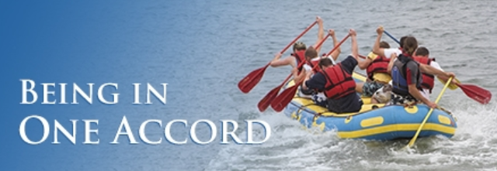

Biblical Conflict Resolution
is NOT:
Seeking Gamesmanship
Winning
Biblical Conflict Resolution
Does :
Transform Disputes to Given Grace, Bonding, Organizational Efficacy
Prevent Lingering Negative Feelings
Protect Dignity Of All
Debating/Proving You’re Way is Right
Balances Humility, Grace, and Decisiveness
It’s Getting to YES…

Slide 7
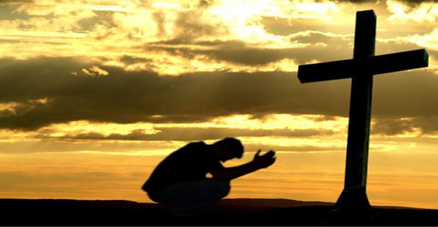
Conflict Resolution in Kairos
Start with the end in mind- glorifying God
We serve by sharing the love of Christ that we have received.
We are called to lay down personal agendas
T

Slide 8
Foundations of the Ministry
Expectations & Standards
Vision
Mission
Core Values
Statement of Faith
Code of Conduct
Program Manuals

Slide 9

    Hazards of Unmanaged Conflict
    We lose focus on God’s will, His Mercy.
    Our witness is impaired..
    Relationships are damaged.
    Trust is broken.
    Communication breaks down.
    Power struggles emerge.

Slide 10

Dealing with Conflict in Kairos
Prepare and train volunteers
Prayerfully select volunteers
Follow Kairos processes
Pray before speaking
Titus 2:7-8
Matthew 18: 15-20

Slide 11
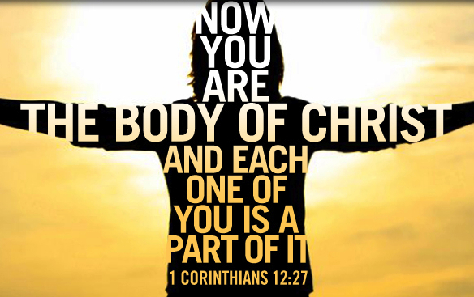
We are called to love, support, serve and encourage .
Ephesians 4:16 (NLT)
“He makes the whole body fit together perfectly. As each part does its own special work, it helps the other parts grow, so that the whole body is healthy and growing and full of love.”

Slide 12
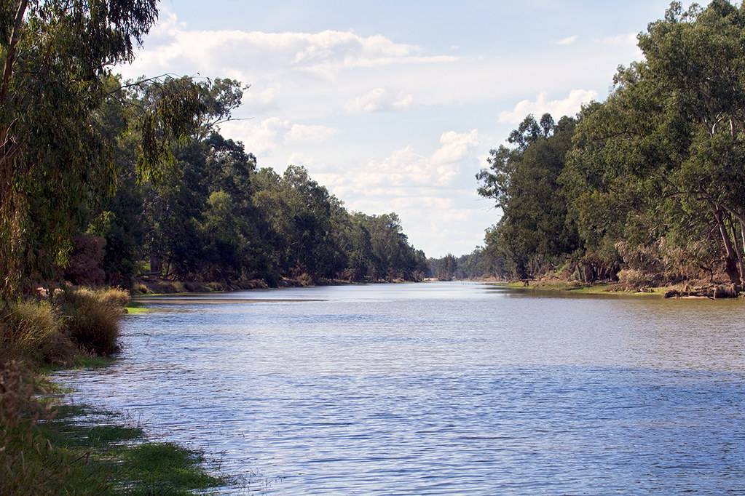
Staying in the Riverbanks
Safeguards of the Ministry
Blessed is the one…whose delight is in the law of the Lord…That person is like a tree planted by streams of water, which yields its fruit in seasons and whose leaf does not wither- whatever they do prospers Psalm 1:1-4

Slide 13

Conflict Resolution Bible Stories
We Should Understand…
Abraham and Lot
Paul and Barnabas
Euodias and Syntyche

Slide 14

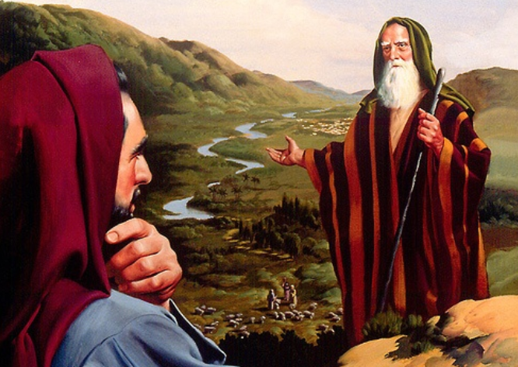
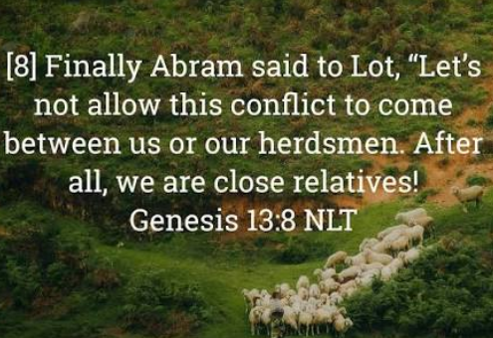
What kind of man was Lot?
Why did Lot choose the city?
Can choosing wrong choices ever be redeemed by God?
What was God’s purpose and judgment?
What do we learn from Abraham and Lot’s disagreement that applies to us in our time and our town (Kairos)?

Slide 15

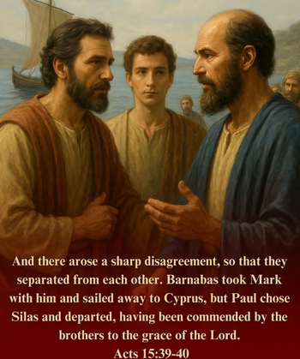
Who was John Mark?
Did the disagreement over John Mark turn out well?
Was the common cause of spreading the Gospel hurt by Paul’s behavior or entrenchment?
What do we know about Paul’s relationship with John Mark in subsequent years?

Slide 16

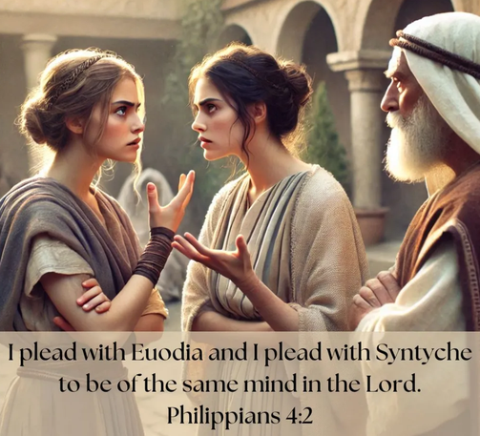
Who were they most likely?
What can we observe and learn whatever their disagreement was?
What does Paul emphasize in his instruction?
What do we take away and fervently apply from the Scripture regarding this incident?

Slide 17

Our Mission
Kairos Inside, Kairos Outside, Kairos Torch
share the transforming love and forgiveness of Jesus Christ to impact the hearts and lives of incarcerated men women, and youth, as well as their families, to become loving and productive citizens of their communities.

Slide 18
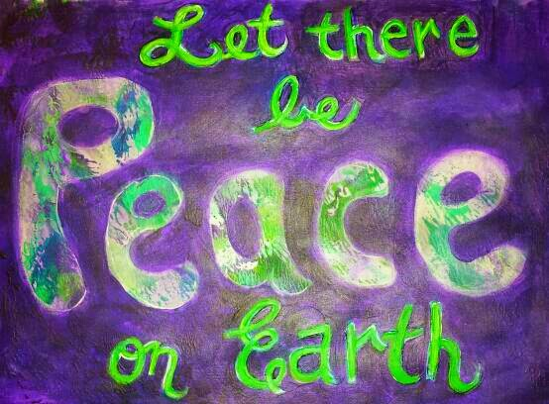
Following the Mission
Cultivating a culture of peace as we resolve conflicts
              Blessed are the peacemakers…
Matthew 5:9
Peacemakers who sow in peace raise a harvest of righteousness - James 3:18

Slide 19
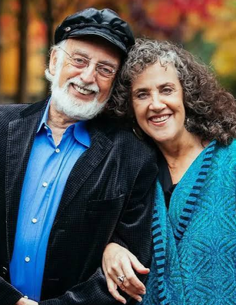

Research Based Conflict Resolution
In Relationships
“Other-Centric” is Highly Biblical
Solvable differences vs. Perpetual differences
How do we become agents of change?
Why Unity matters above being “right.”
Win the Conflict…?
Or
Build Relationship?

Slide 20

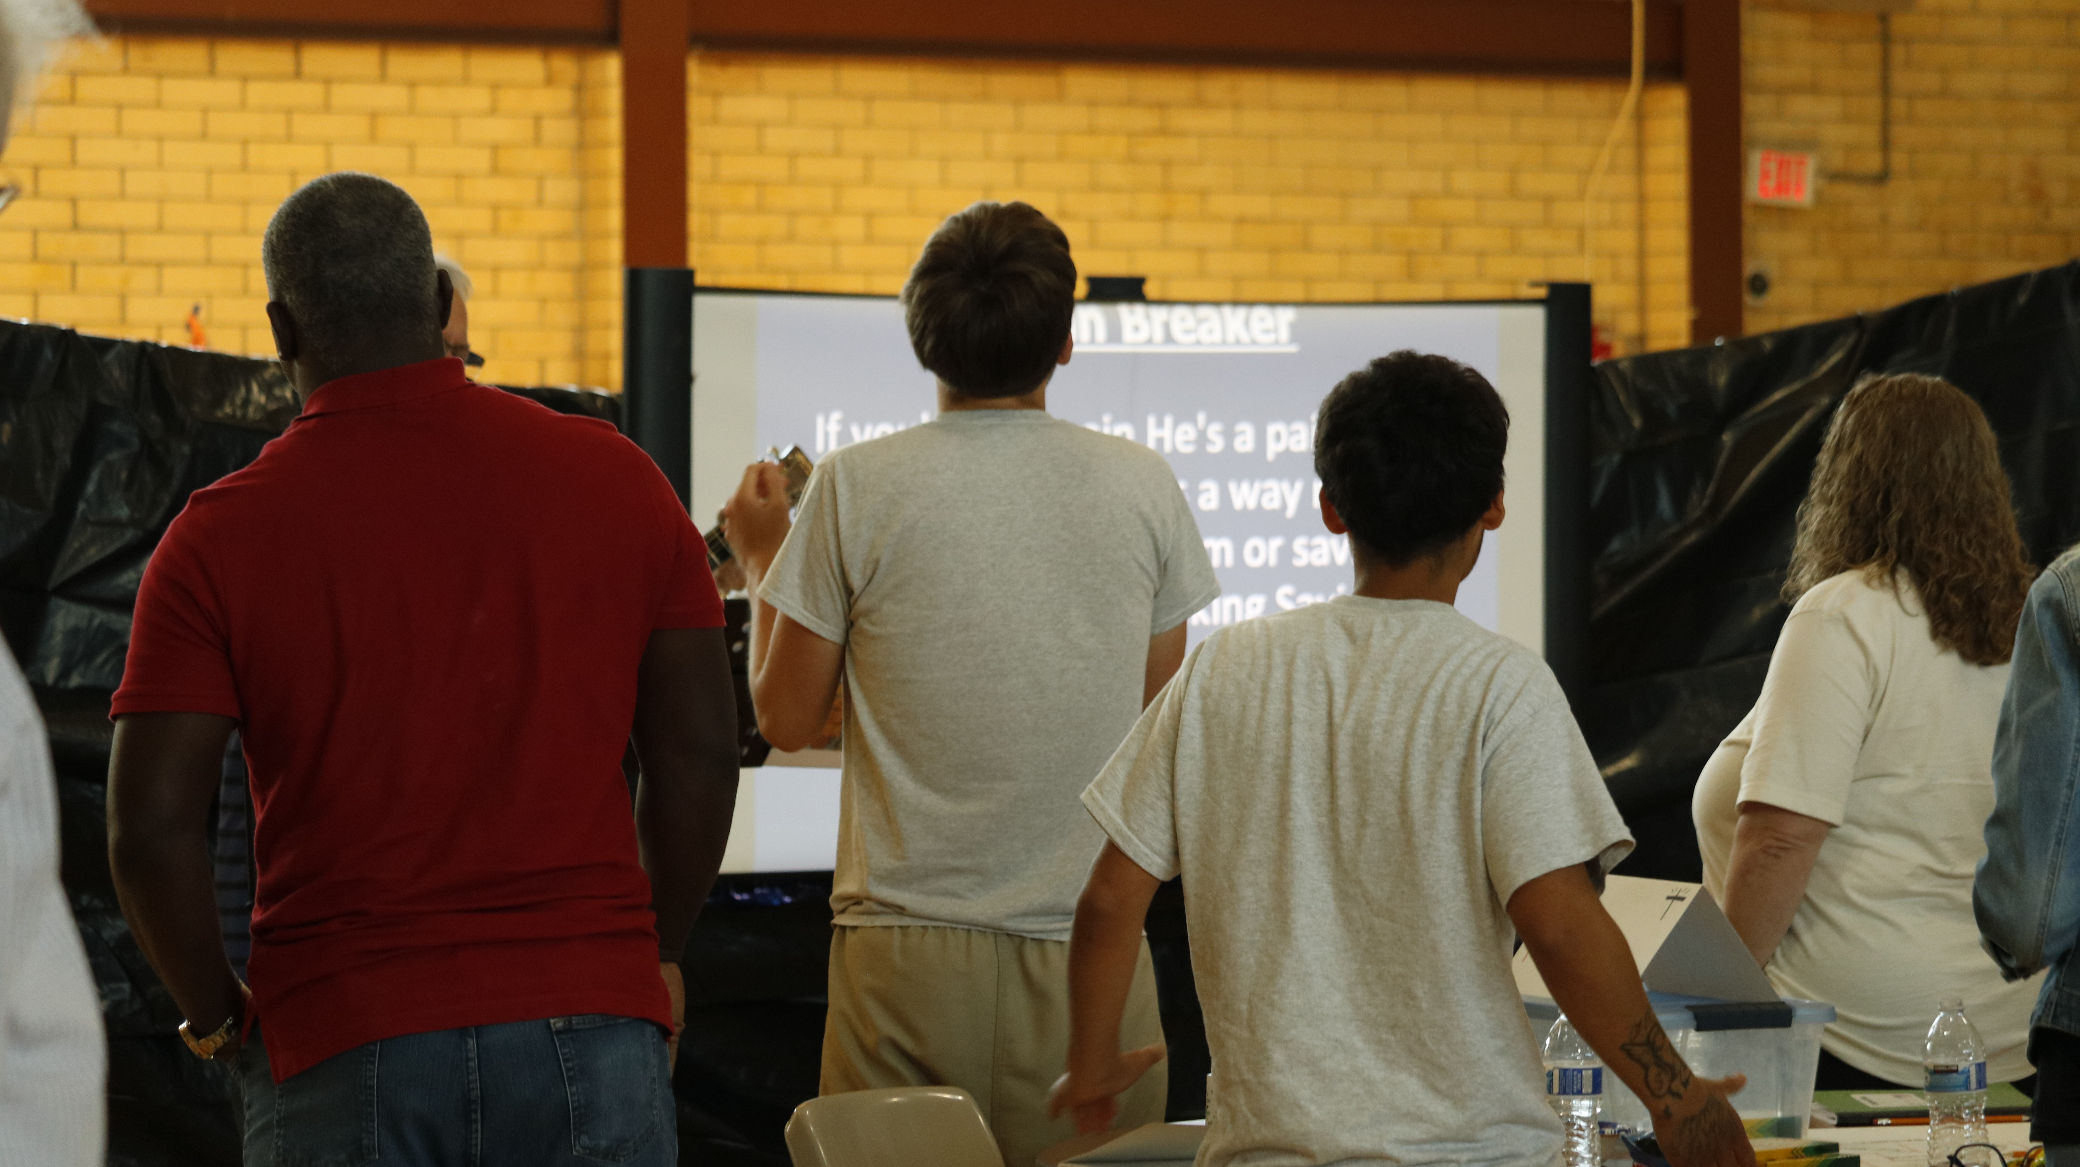

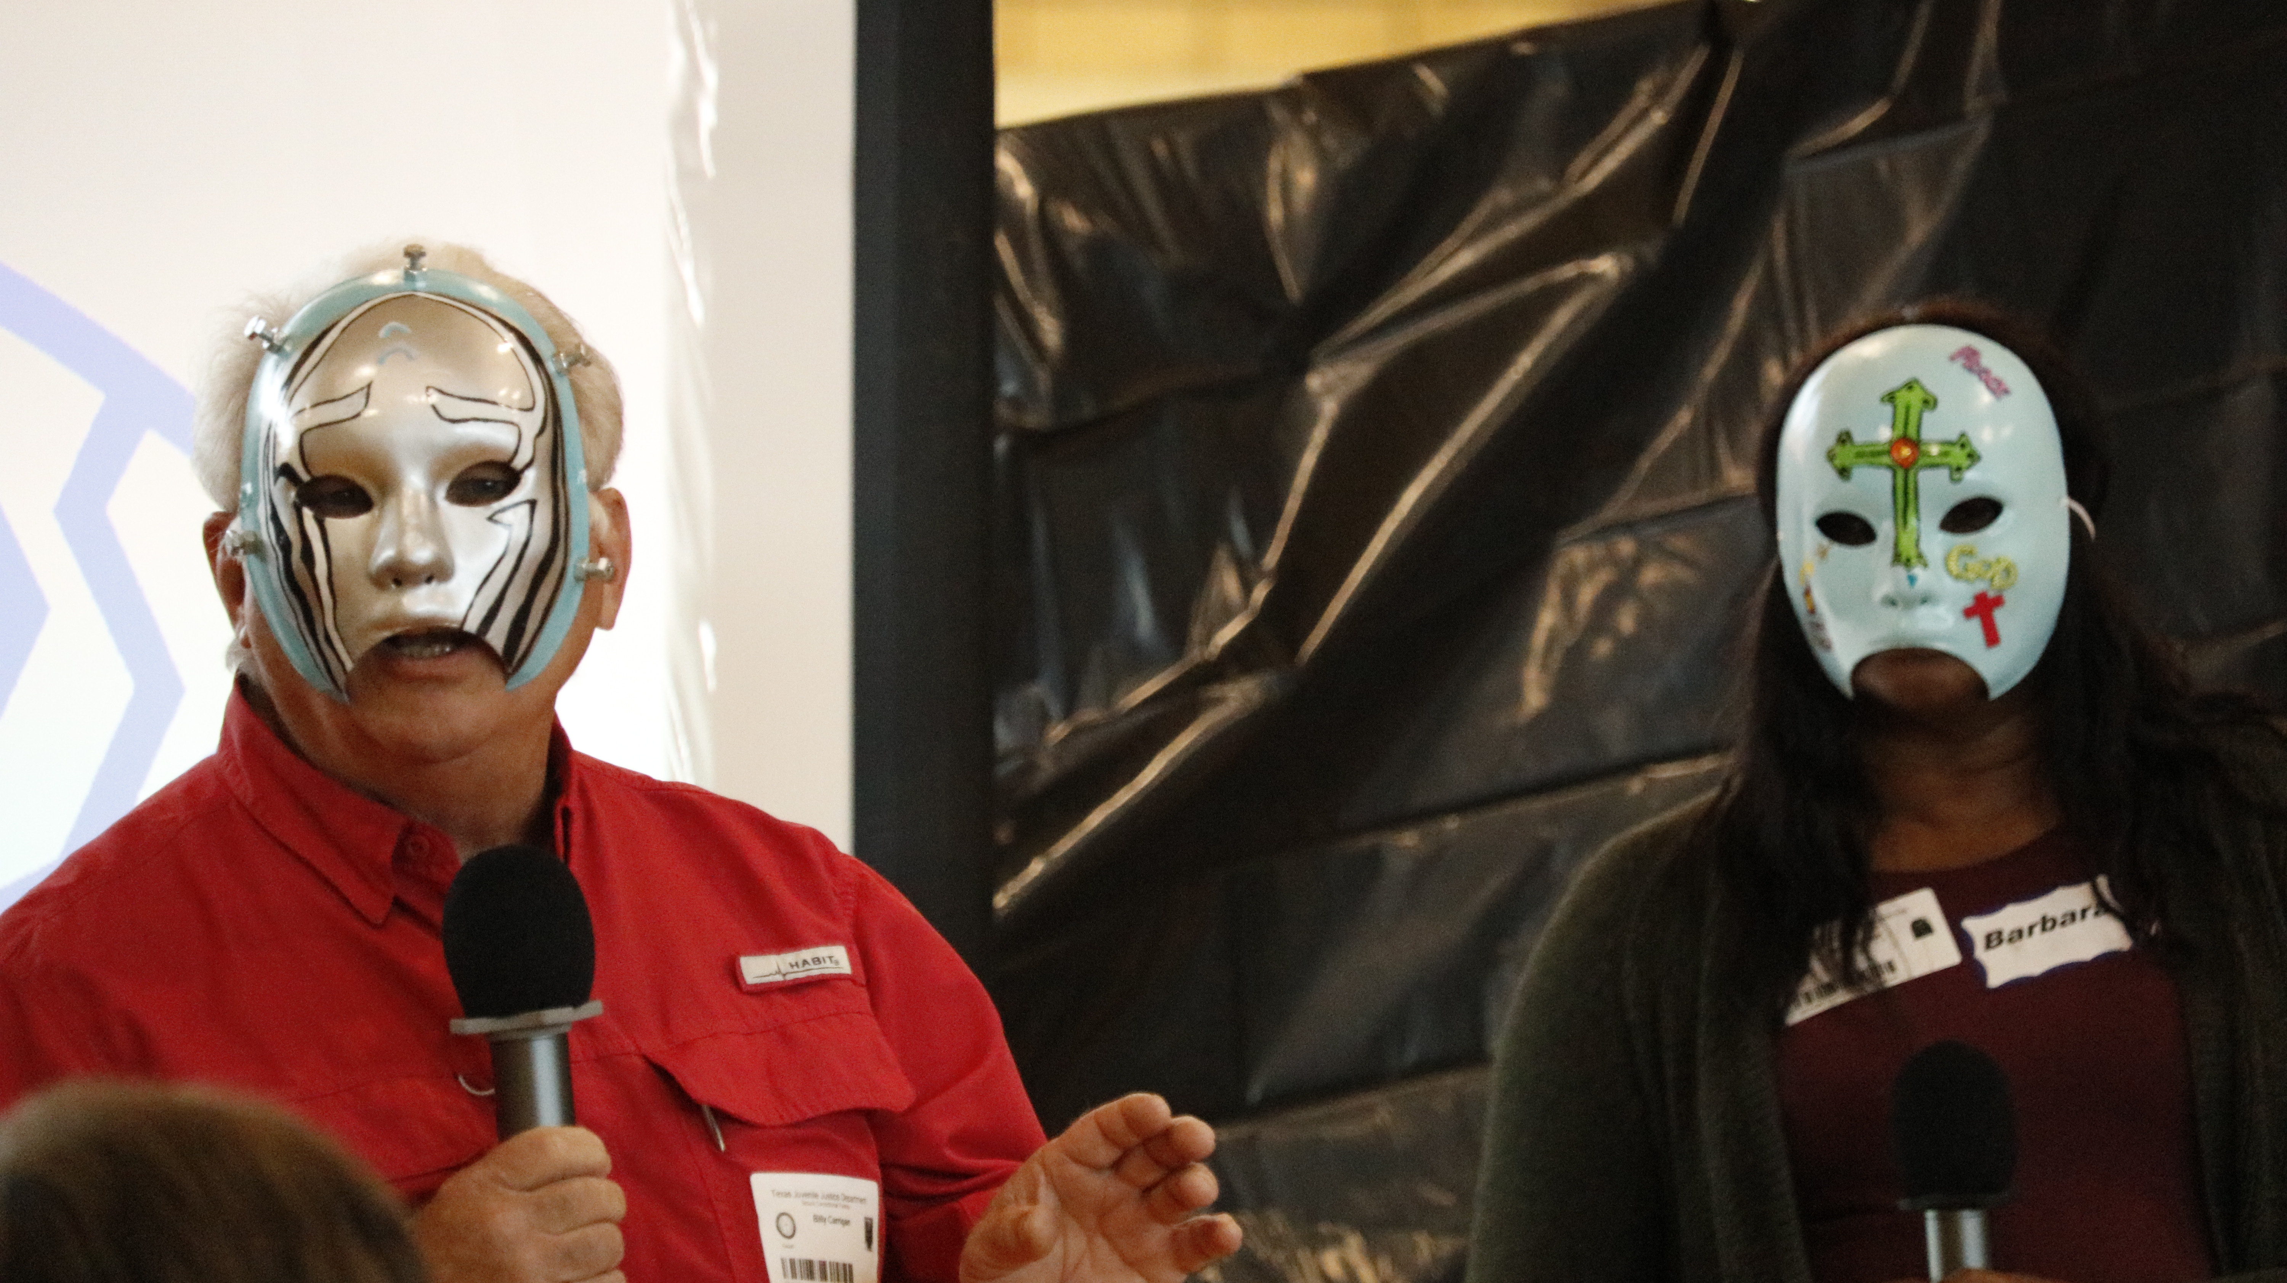
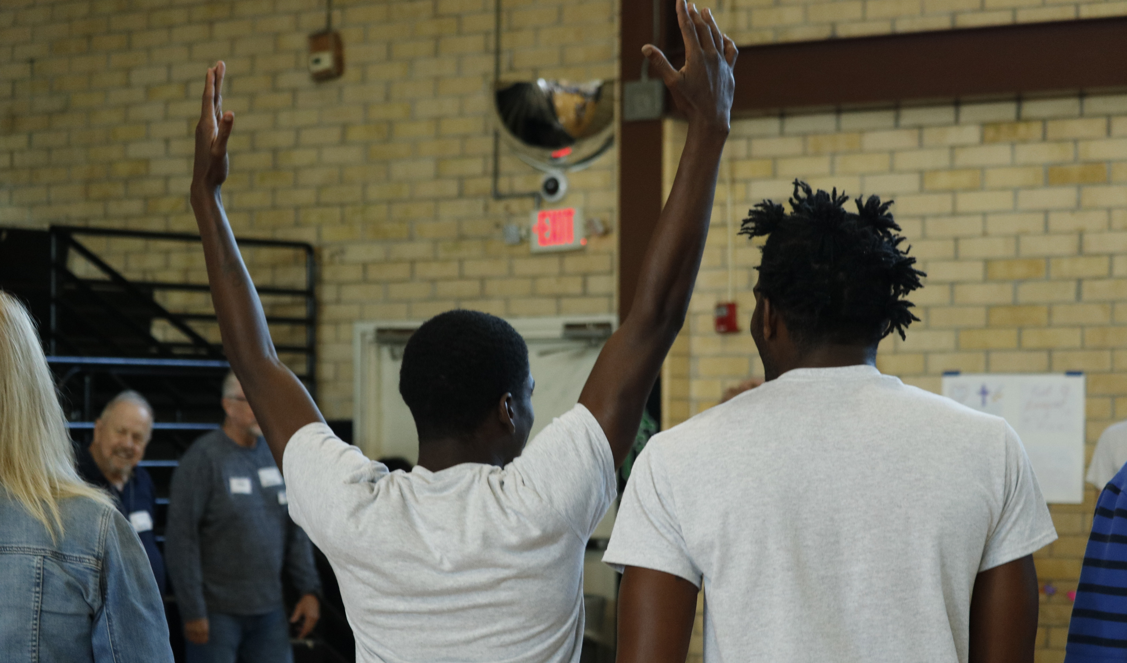
In Kairos, We Sing From the
Same Music Score…

Slide 21
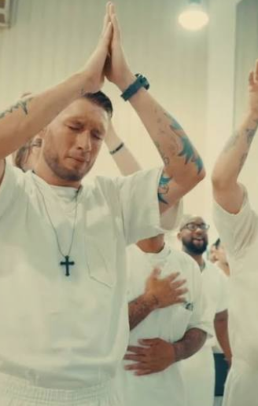
Singing From the Same Music…
Leaves the RIGHT Witness and Impression…
On Incarcerated Participants
On Prison Staff
On Ourselves…
That we are special friends who
know and love each other… who journey together
because of Jesus

Slide 22
Questions
&
Answers

Slide 23
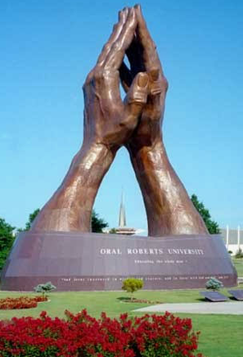
Closing Prayer

